Slide 1

Data, Data Science, and Databases to enable Drug Discovery
Lecture 2
CBMC 805; Fall 2024

Slide 2












Information resources for bioactive chemicals are abundant and growing
The FDA Safety Information and Adverse Event Reporting Program
FDA Orange Book of
Approved Drug Products
Compound Assay data for proteins and cytotoxicity
Over 18 million citations from MEDLINE and other life science journals for biomedical articles back to the 1950s
FDA data for five liver enzyme endpoints for
Integrated
Chemical-
Bioactivity
Data
FDA approved labels for marketed drugs
The DrugBank database combines detailed drug data (8200+ drug entries) with comprehensive drug target information
eMC provides electronic Summaries of Product Characteristics
European Public Assessment Reports (EPAR)
Cytochrome P450 Drug Interaction Table
Reflects the scientific conclusion reached by the Committee for Medicinal Products for Human Use (CHMP) at the end of the centralised evaluation process.
“Potential Safety Issue” data
“Drug Interactions” table
FDA New Drug Application documents
Drug interactions with cytochrome P450 isoforms
Modified from a slide provided by Julie Barnes, Biowisdom

Slide 3
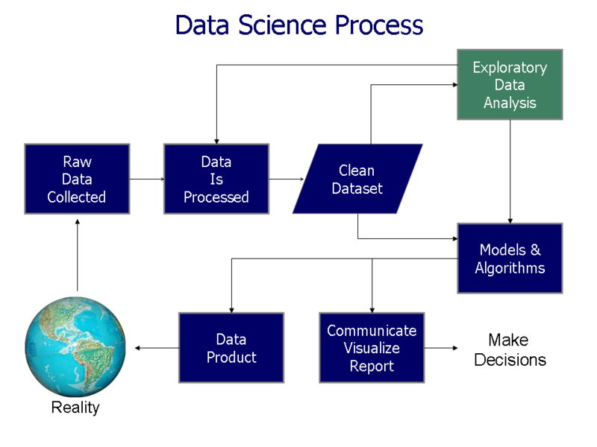
Data Science Workflow (Wikipedia)

Slide 4
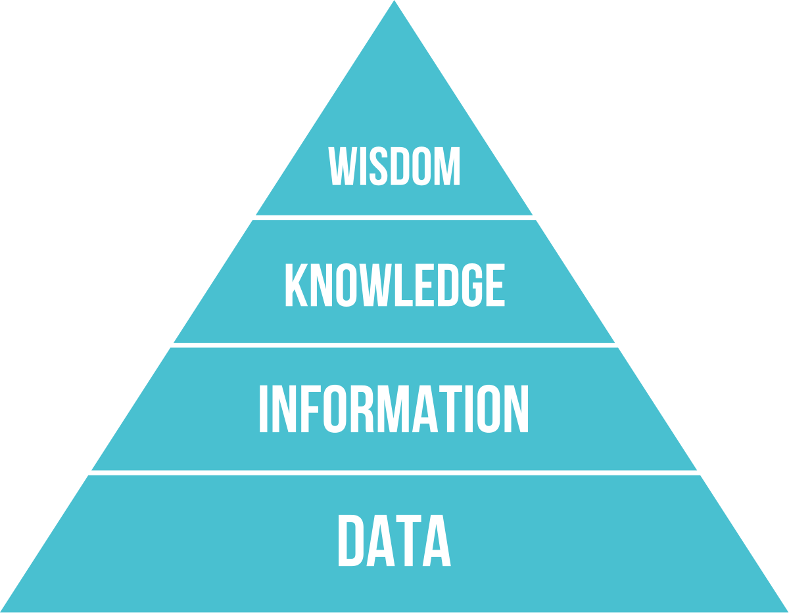
The General Knowledge (DIKW) Pyramid
https://en.wikipedia.org/wiki/DIKW_pyramid

Slide 5
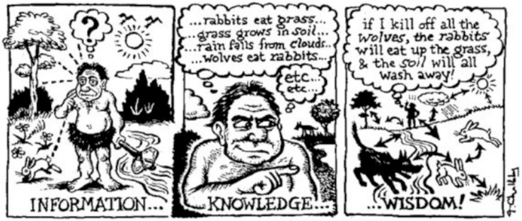
A DIKW Example

Slide 6
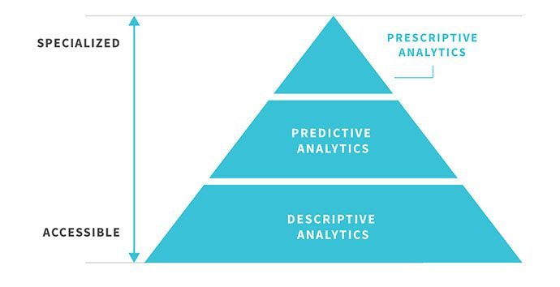
The Data Science Activity Continuum
make more breakthrough discoveries and increase operational efficiency and profitability
Chris Waller, VP, Chief Scientist, EPAM United States

Slide 7
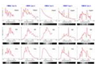
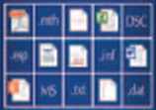
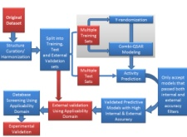
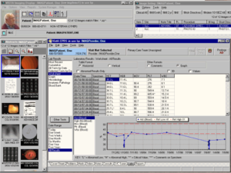
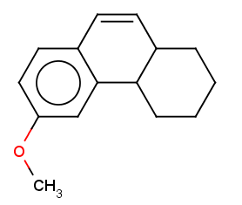
Data Science and Data Cycle
Unstructured texts: Facebook Twitter Other Social Media
Electronic Databases:
Data Analysis
Data reproducibility and data curation are critical, otherwise:
BD2K = Bogus Data
to Knonsense
Structured
Data
Repository
Data Analysis and Modeling (aka QSAR)
Text Mining
Lab collections
Processing
Literature data
Data collection, curation, integration, and structuring (ontology)
Disease
Effect
New data
Experimental Validation
Experimental Design
Predictive data
models & tools
Decision Support

Slide 8
Data Repositories and Knowledgebases
Data Repositories
Biomedical data repositories accept the submission of relevant data from the research community to store, organize, validate, archive, preserve, and distribute data in compliance with the FAIR Data Principles.
Curation focuses on quality assurance and quality control.
Example: Pubchem
Knowledgebases
Biomedical knowledgebases extract, accumulate, organize, annotate, and link the growing body of information that is related to, and relies on, core datasets.
Significant levels of human curation are traditionally required.
Example: Protein Data Bank (RCSB); ChEMBL

Slide 9
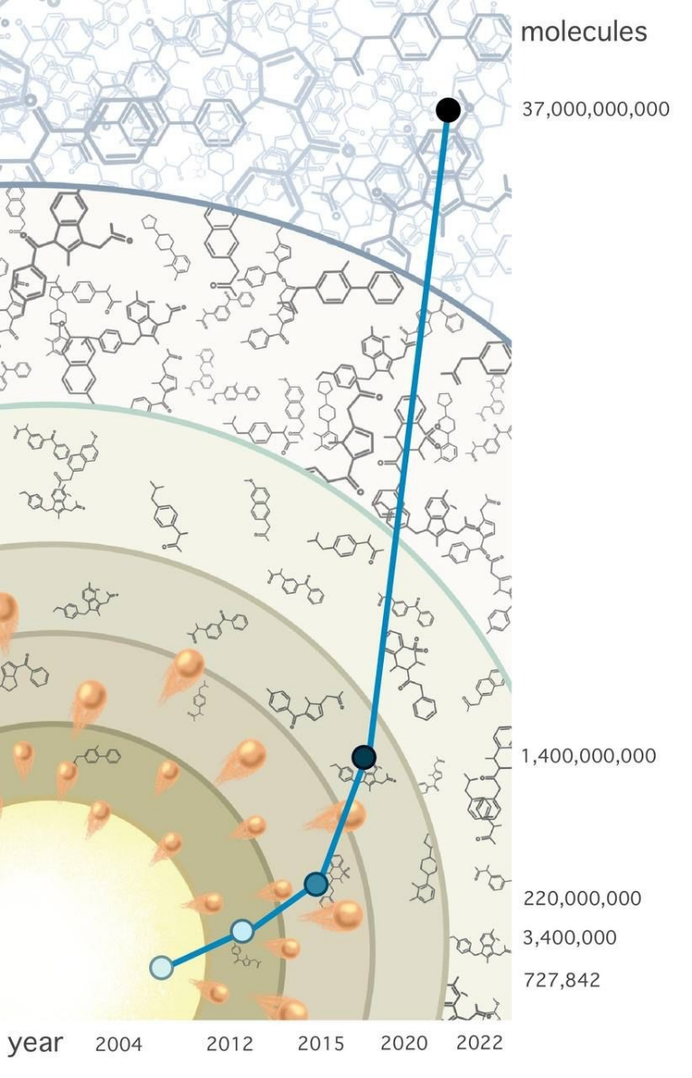
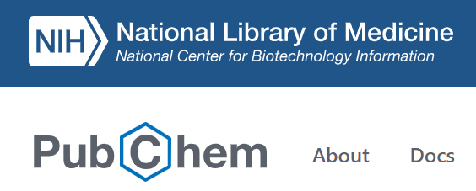

Acceleration of drug discovery in the age of Big Data: new methods needed!
40+B of purchasable chemicals!!!
Knowledge mining
Virtual Screening
Over 41 million abstracts and 8.7 million full-text articles, adding over 1.7 million new articles annually.
Cherkasov, A. The ‘Big Bang’ of Chemical Universe. Nature Chemical Biology, 19, 667–668 (2023)
Pandey M., et al. The transformational role of GPU computing and deep learning in drug discovery. Nature Mach. Intel. 2022 4, 211–221
Tropsha. A., et al. Integrating QSAR modelling and deep learning in drug discovery: the emergence of deep QSAR. Nature Rev. Drug Disc, 2023, https://doi.org/10.1038/s41573-023-00832-0

Slide 10
Scientific literature as a source of data-driven discovery: Swanson’s ABC approach to drug discovery via text mining*
Vasodilation
Spreading cortical depression
Platelet aggregation
B
Biochemical effects
Relationships established through co-occurrence of terms
Relationships established through co-occurrence of terms
A
Chemicals
C
Disease
Magnesium
Deduced relationship
Migraine
*Swanson DR. Medical literature as a potential source of new knowledge.
Bull Med Libr Assoc 1990;78(1):29–37

Slide 11
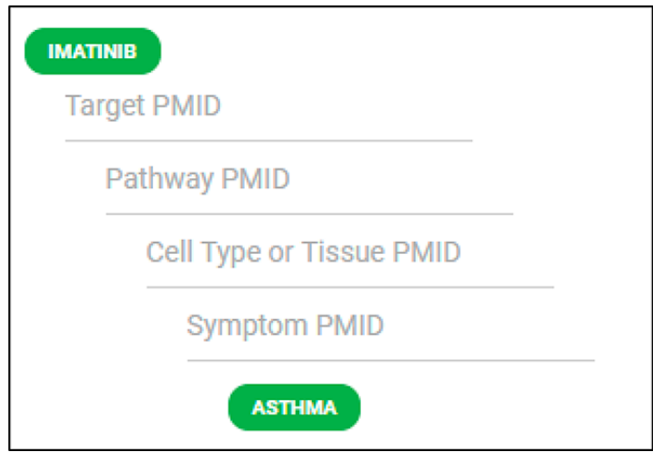
Establishing Clinical Outcomes Pathways
(COPs) of drug action
COPs explain how a drug elicits its effect on a disease
Chemotext can be used to elucidate COPs
Proto-Oncogene Proteins c-kit (PMID: 19722748)
Phosphatidylinositol 3-Kinases (PMID: 17546049)
Mast Cells (PMID: 16483568)
Bronchial Hyperreactivity (PMID: 24112389)

Slide 12
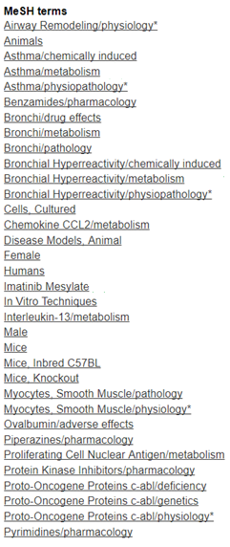
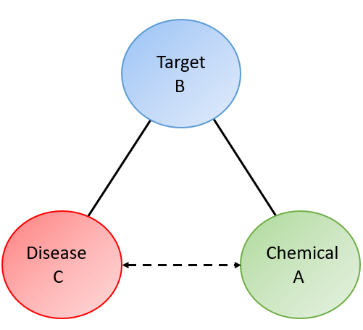
Chemotext (chemotext.mml.unc.edu)
A publicly-available Web server that mines the entire PubMed using Medline Subject Heading (MeSH) terms
Data retrieved from the MEDLINE/PubMed Baseline Repository (MBR) in June 2017
Chemotext database contains 19,282,732 articles and 78,758,882 connections (vertices) between terms
Connections are made based on MeSH terms
Chemical terms = A
Protein/Pathway terms = B
Disease terms = C
Mining PubMed affords rapid identification of connections between vertices and enabling new inferences of such connections
Capuzzi SJ, et al., Chemotext: A Publicly Available Web Server for Mining Drug-Target-
Disease Relationships in PubMed. J Chem Inf Model. 2018 58(2):212-218

Slide 13
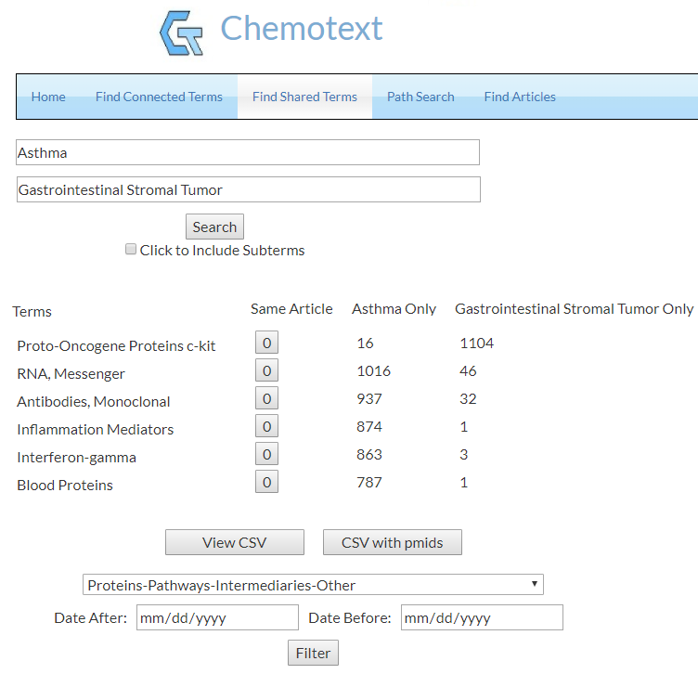
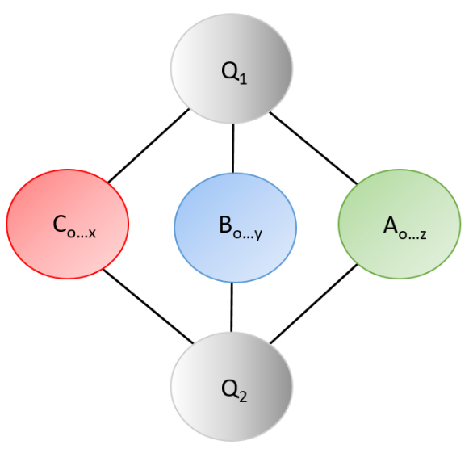
Shared Terms Module
Two query terms are input, and co-occurring terms that are shared between the queries are returned.
Chemotext (chemotext.mml.unc.edu)

Slide 14
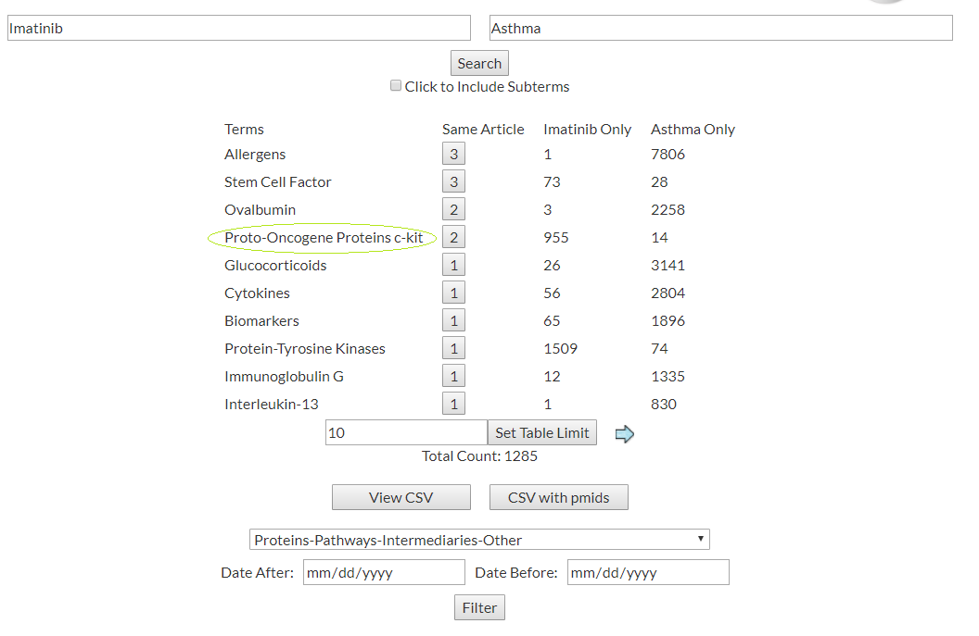
Case Study: Imatinib-Asthma COP
Query terms “Imatinib” (i) and “Asthma” (vi) were searched in the Find Shared Terms
One article (PMID: 19722748), i.e., “Presence of c-KIT-positive mast cells in obliterative bronchiolitis from diverse causes”, was successfully chosen as the solution to stage (ii) of the COP, as confirmed by the NCATS Challenge system

Slide 15
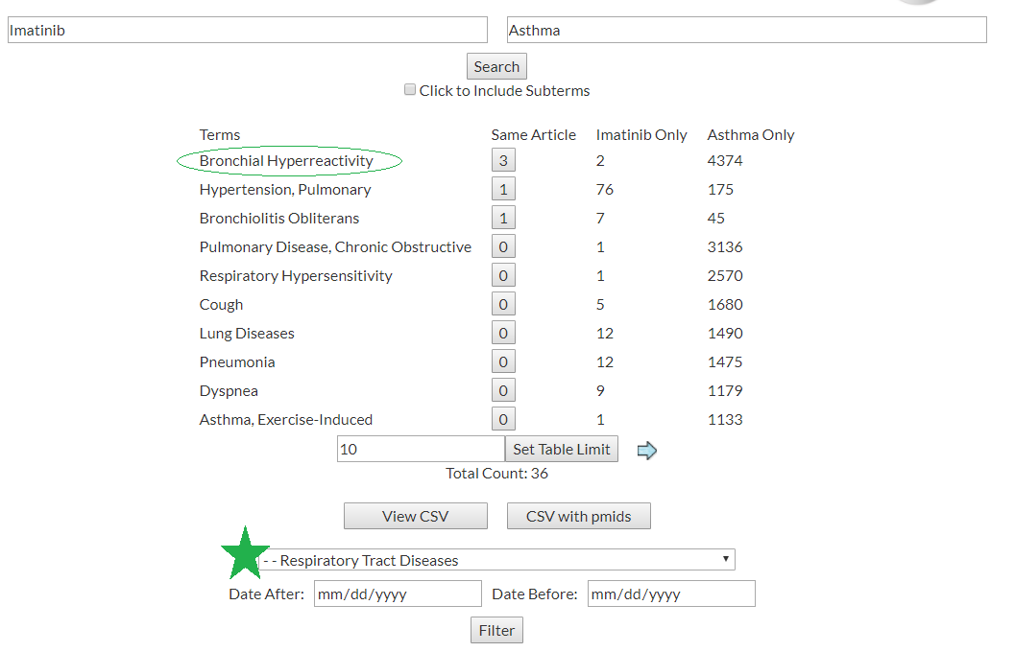
Case Study: Imatinib-Asthma COP
Query terms “Imatinib” (i) and “Asthma” (vi) were searched in
the Find Shared Terms
Bronchial Hyperreactivity (PMID: 24112389), i.e., “role of Abl in airway hyperresponsiveness and airway remodeling.”, was successfully chosen as the solution to stage (v) of the COP, as confirmed by the NCATS Challenge
The full Imatinib-Asthma COP, as revealed by Chemotext, is: Imatinib (i) → Proto-Oncogene Proteins c-kit (ii) → Phosphatidylinositol 3-Kinases (iii) → Mast Cells (iv) → Bronchial Hyperreactivity (v) → Asthma (vi).

Slide 16
Bibliometric overview of drug repurposing using PubMed
General definition: finding new therapeutic uses for an existing drug
Bibliometric Approach: – analysis of publications in PubMed
Study-specific definition: literature record of a therapeutic use (or study thereof) beyond the historically first report on the drug use
Baker NC, Ekins S, Williams AJ, Tropsha A. A bibliometric review of drug repurposing.
Drug Discov Today, 2018, Mar;23(3):661-672. doi: 10.1016/j.drudis.2018.01.018.

Slide 17
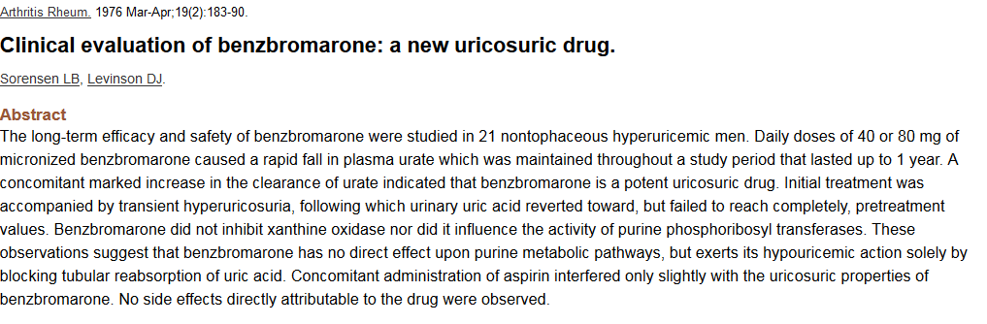
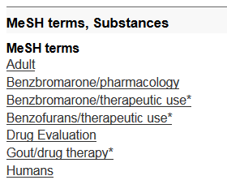
How we get the data from the article citations
ReprofileSet
PubMed ID | Pub Yr | Chemical | Disease | Clinical Trial?
1259799 | 1976 | Benbromarone | Gout | Yes
Annotations become data
Year
MeSH terms – controlled vocabulary

Slide 18
What the data doesn’t tell us
Whether a drug and indication were approved
Whether the drug went to market
Whether the drug was efficacious
Whether the drug was safe
How much money it made

Slide 19
Results Overview
Disease Count | How many chemicals
1-10 | 29,459
20 | 1,928
30 | 781
40 | 461
50 | 289
60 | 237
70 | 164
80 | 145
90 | 107
100 | 89
110 | 72
120 | 63
130 | 54
140 | 48
150 | 37
160 | 40
170 | 31
180 | 28
190 | 30
200 | 26
>200 | 285
14,000 chemicals associated with 1 disease only.
Can you guess which drugs have been reprofiled the most?
These are the chemicals that have been reprofiled the most.

Slide 20
Chemicals associated therapeutically with the most diseases
Chemical Name | Disease Count | Article Count | Clinical Article Count
Prednisolone | 1340 | 8472 | 1541
Dexamethasone | 1317 | 8386 | 1990
Prednisone | 1162 | 8388 | 1567
Methylprednisolone | 1135 | 6664 | 1396
Interferon-alpha | 879 | 17323 | 4924
Ascorbic Acid | 840 | 3579 | 746
Cyclosporine | 838 | 6369 | 1288
Cyclophosphamide | 817 | 11086 | 2044
Hydrocortisone | 809 | 3472 | 640
Methotrexate | 798 | 12584 | 2166
Aspirin | 789 | 9072 | 2534
Vitamin E | 787 | 3621 | 819
Heparin | 779 | 8726 | 1416
Immunoglobulin G | 692 | 4844 | 918
Indomethacin | 688 | 4520 | 1113
Ethanol | 688 | 4284 | 466
Lidocaine | 646 | 3800 | 1185
Doxycycline | 633 | 3058 | 977
Acetylcysteine | 627 | 2324 | 534
Adrenocorticotropic Hormone | 627 | 4149 | 266
Propranolol | 622 | 7079 | 1895
Cortisone | 607 | 3407 | 39
Sirolimus | 605 | 5132 | 987
Tetracycline | 599 | 3769 | 670
Can you guess which diseases have the most drugs tried on them?
Notes:
Query : presoverview1
Latest update 5/27/2011. QA against pubmed. Difference accounted for by subtype (non therapeutic).
Need to redo this report with better numbers after update of chemdis. (Also cleanup of signs and symptoms)

Slide 21
Disease – drug count from ReprofilingSet
Disease | Count of drugs | Count of drugs studied clinically
Neoplasms | 4709 | 1897
Breast Neoplasms | 3373 | 1080
Lung Neoplasms | 3052 | 994
Inflammation | 2985 | 727
Pain | 2392 | 1290
Neoplasms, Experimental | 2285 | 127
Colonic Neoplasms | 2206 | 320
Adenocarcinoma | 2200 | 809
Prostatic Neoplasms | 2120 | 678
Hypertension | 1921 | 1100
Edema | 1799 | 342
Liver Neoplasms | 1797 | 589
Diabetes Mellitus, Experimental | 1723 | 26
Melanoma | 1695 | 632
Asthma | 1669 | 985
Ovarian Neoplasms | 1586 | 573
Myocardial Infarction | 1575 | 740
Brain Ischemia | 1485 | 331
Out of nearly 5,000 disease MeSH terms

Slide 22
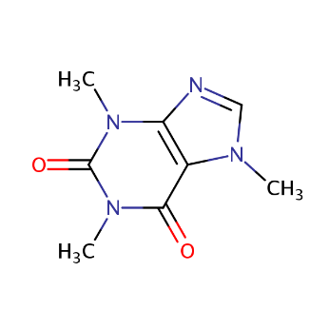
Quick story of Caffeine Repurposing
Over 350 diseases in which caffeine used / tried as treatment
Let’s take a look at some of them …

Slide 23
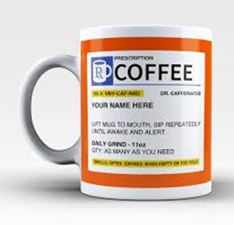
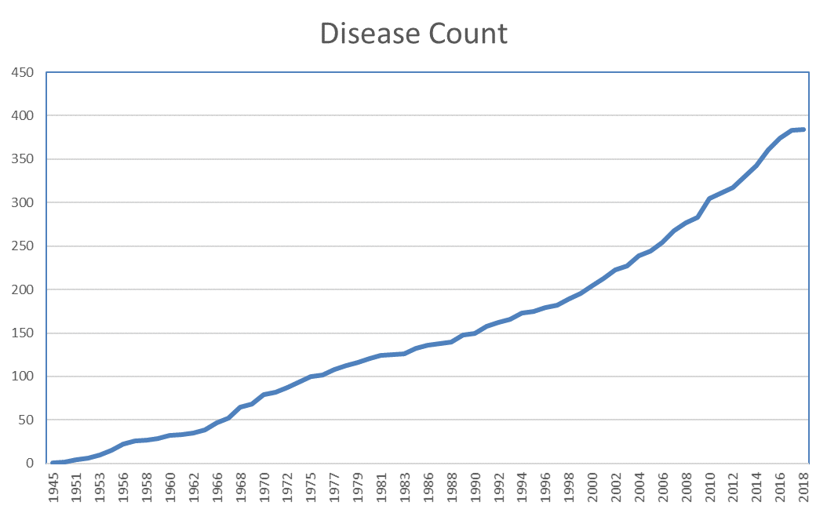
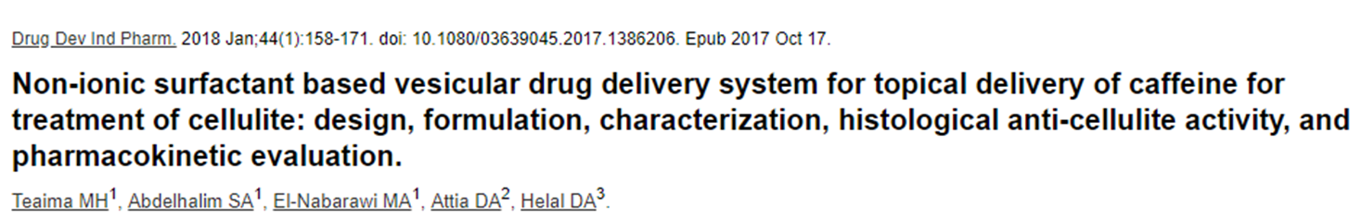
Caffeine and 2018
Enjoy!

Slide 24
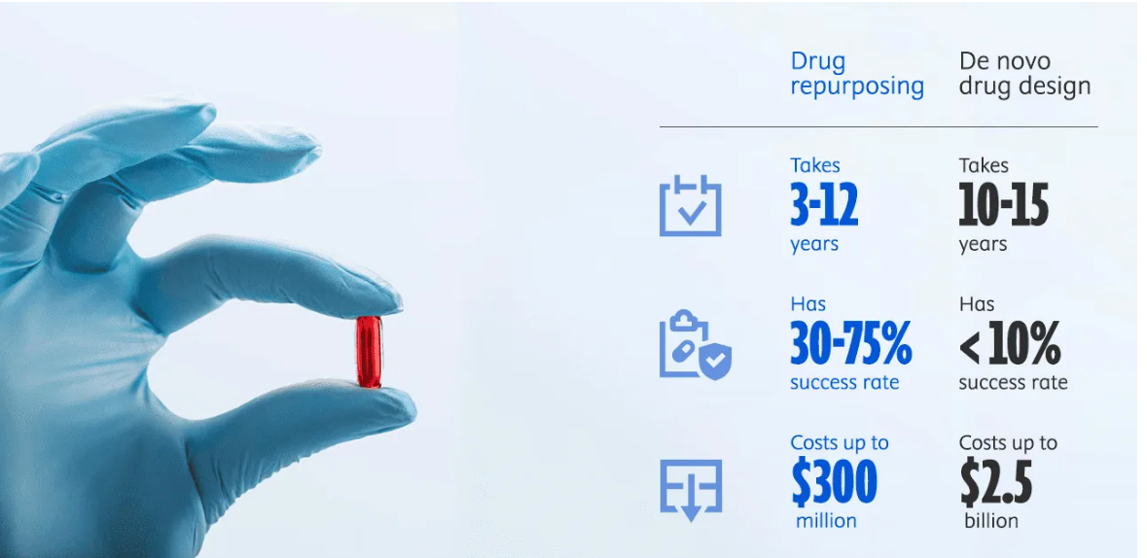
Drug Repurposing: using existing drugs for new diseases
Data source: https://doi.org/10.1016/j.csbj.2020.04.004
Image source: https://www.elsevier.com/industry/drug-repurposing

Slide 25
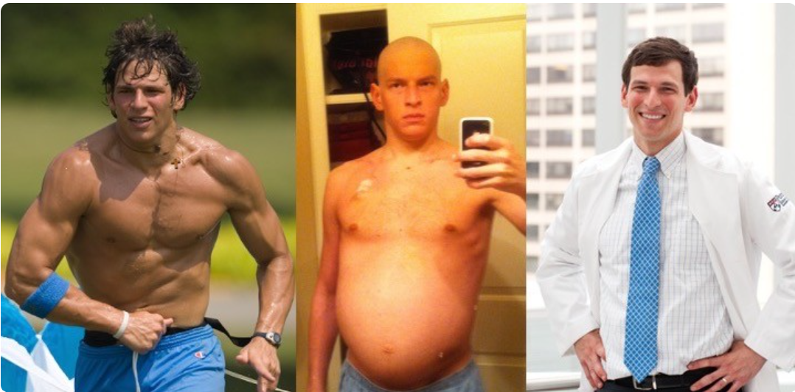
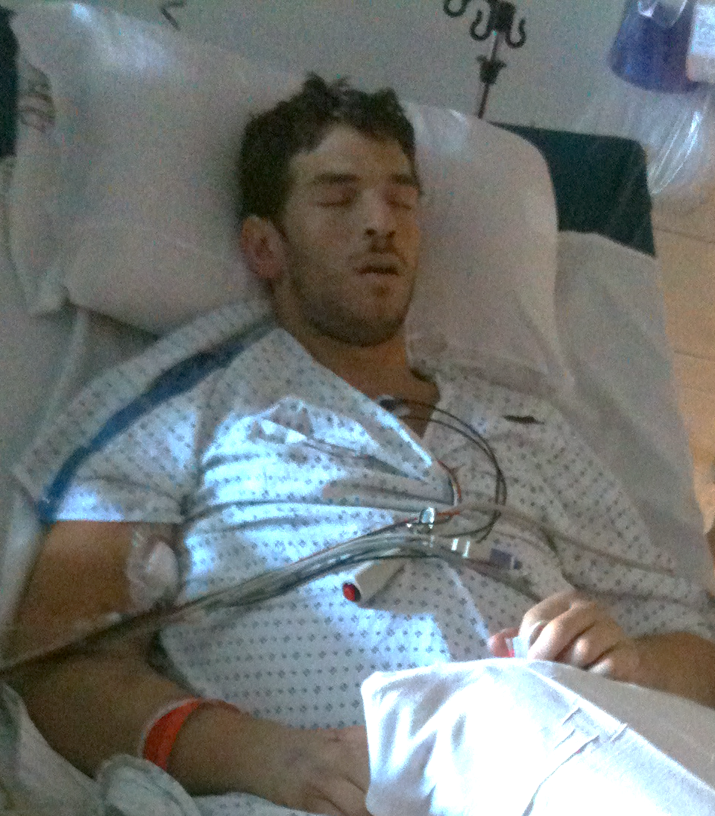
An amazing story of one rare disease
patient
Courtesy of Dr. David Fajgenbaum
Notes:
This topic is very personal to me. My doctors told me
We’ve tried everything. There’s nothing else we can do. I even had my last rites read to me in 2010.

Slide 26
?
Elevated cytokines
Increased VEGF
T cell
activation
Idiopathic multicentric Castleman disease

Slide 27
mTOR? Sirolimus?!!!
Elevated cytokines
Increased VEGF
T cell
activation
Idiopathic multicentric Castleman disease

Slide 28
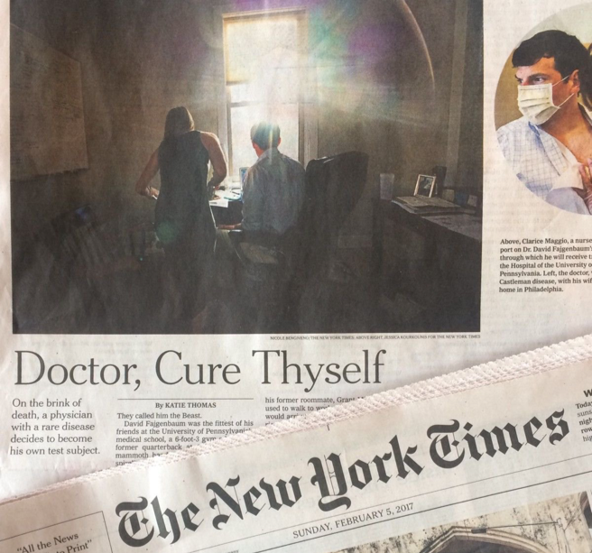
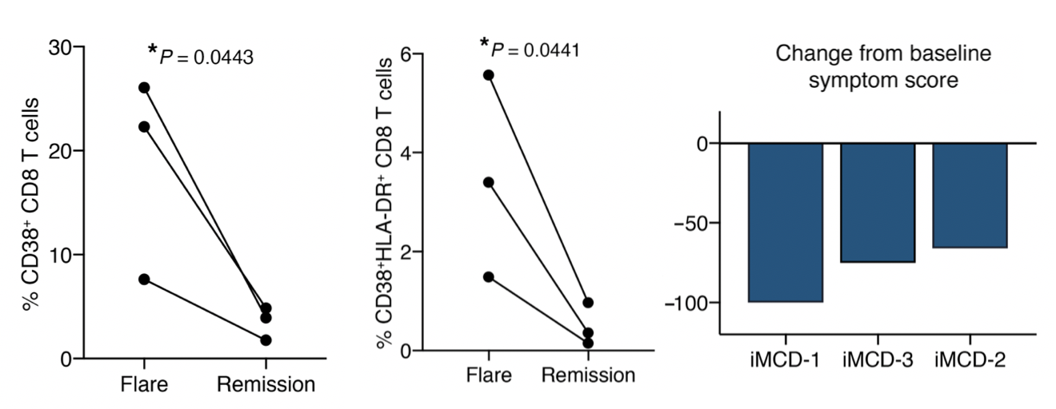
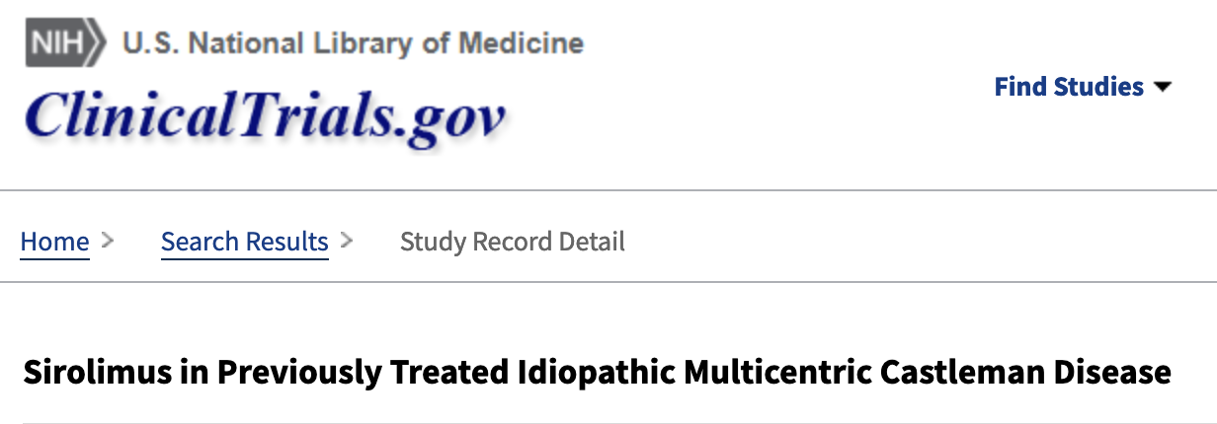
>10 years in Remission!
Fajgenbaum et al. JCI. 2019.
Pai et al. JCI Insight. 2020.

Slide 29
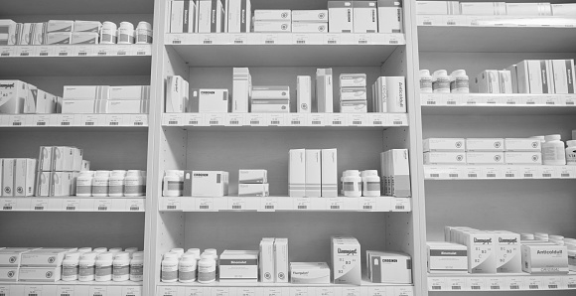

How many cures sit on the pharmacy shelf…
Courtesy of Dr. David Fajgenbaum

Slide 30

…while the data able to link these drugs and diseases hide in plain sight?
Courtesy of Dr. David Fajgenbaum

Slide 31
Many existing medicines already have data supporting their use in other diseases, but they aren’t being pursued due to systemic barriers
3,000+ diseases with an approved medicine
3,000+ FDA-approved medicines
9,000+ diseases that may be able to benefit from existing medicines

Slide 32

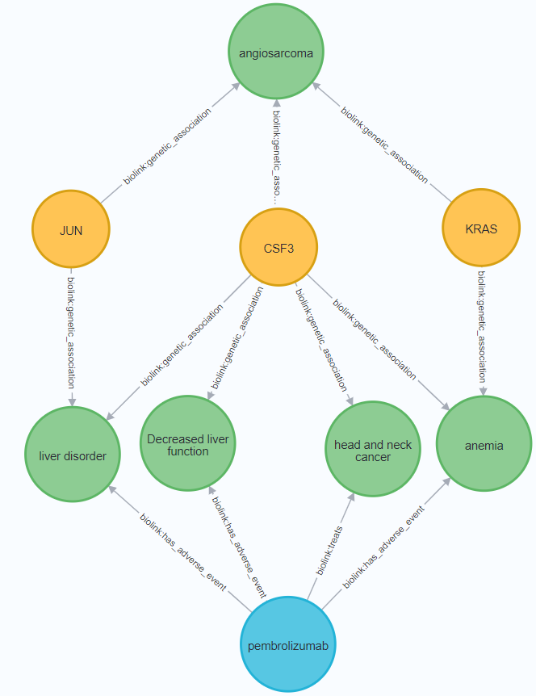





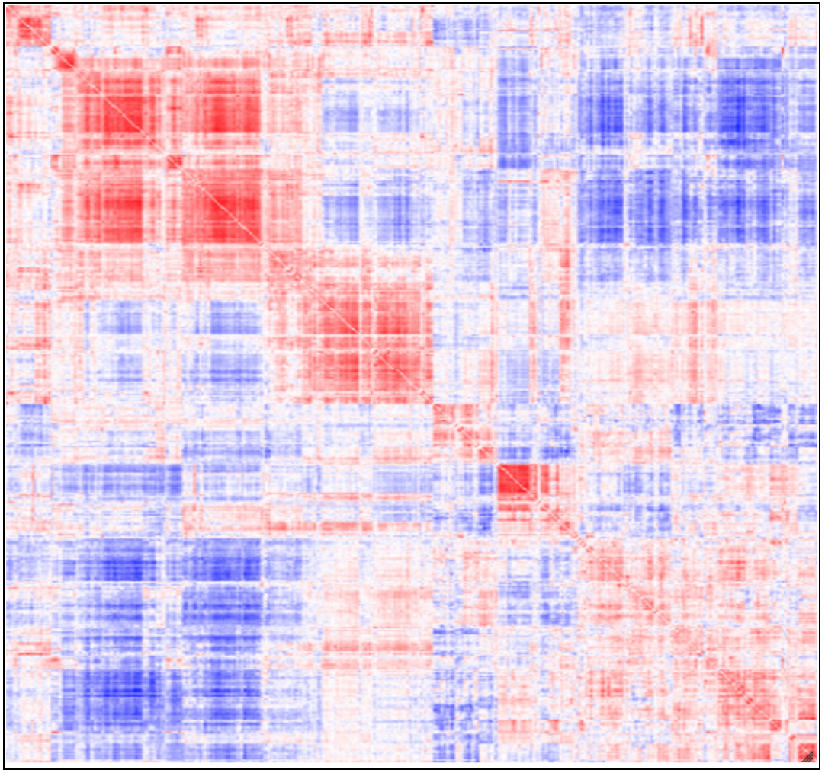














Challenge: grade all 36M drug-disease links and identify promising repurposing candidates (collaboration with EveryCure, CZI)*
Identify and grade all 36M drug-disease links
Evaluate promising hits
Study in trials
Optimize clinical use
Knowledge graph of drugs, targets, and diseases
Ensure treatment is covered
ROBOKOP
← 3,000 approved drugs
$
Evaluate retrospective
clinical data
NLP analysis of literature
12,000 diseases →
Enable immediate patient use
In vitro & in vivo lab validation
Perform clinical trial
Proprietary data
Real world drug-disease data
0.93
AI & quantum
in silico validation
Pharma: add’l uses of drugs
Tuning
Approvals, trial results, AI
Evaluate hits by disease orgs & advisors
Gain FDA approval
Grading validation
*Funded by ARPA-H (with David Fajgenbaum, EveryCure)
Public DataViewer
Evaluation by external groups
Clinical trials by external groups

Slide 33
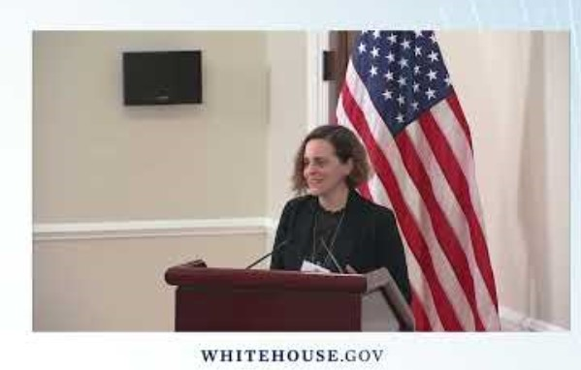

EveryCure and collaborators including UNC-RENCI receive $48.3M grant from ARPA-H
https://6abc.com/dr-david-fajgenbaum-every-cure-rare-disease-forum-university-of-pennsylvania/14479463/

Slide 34
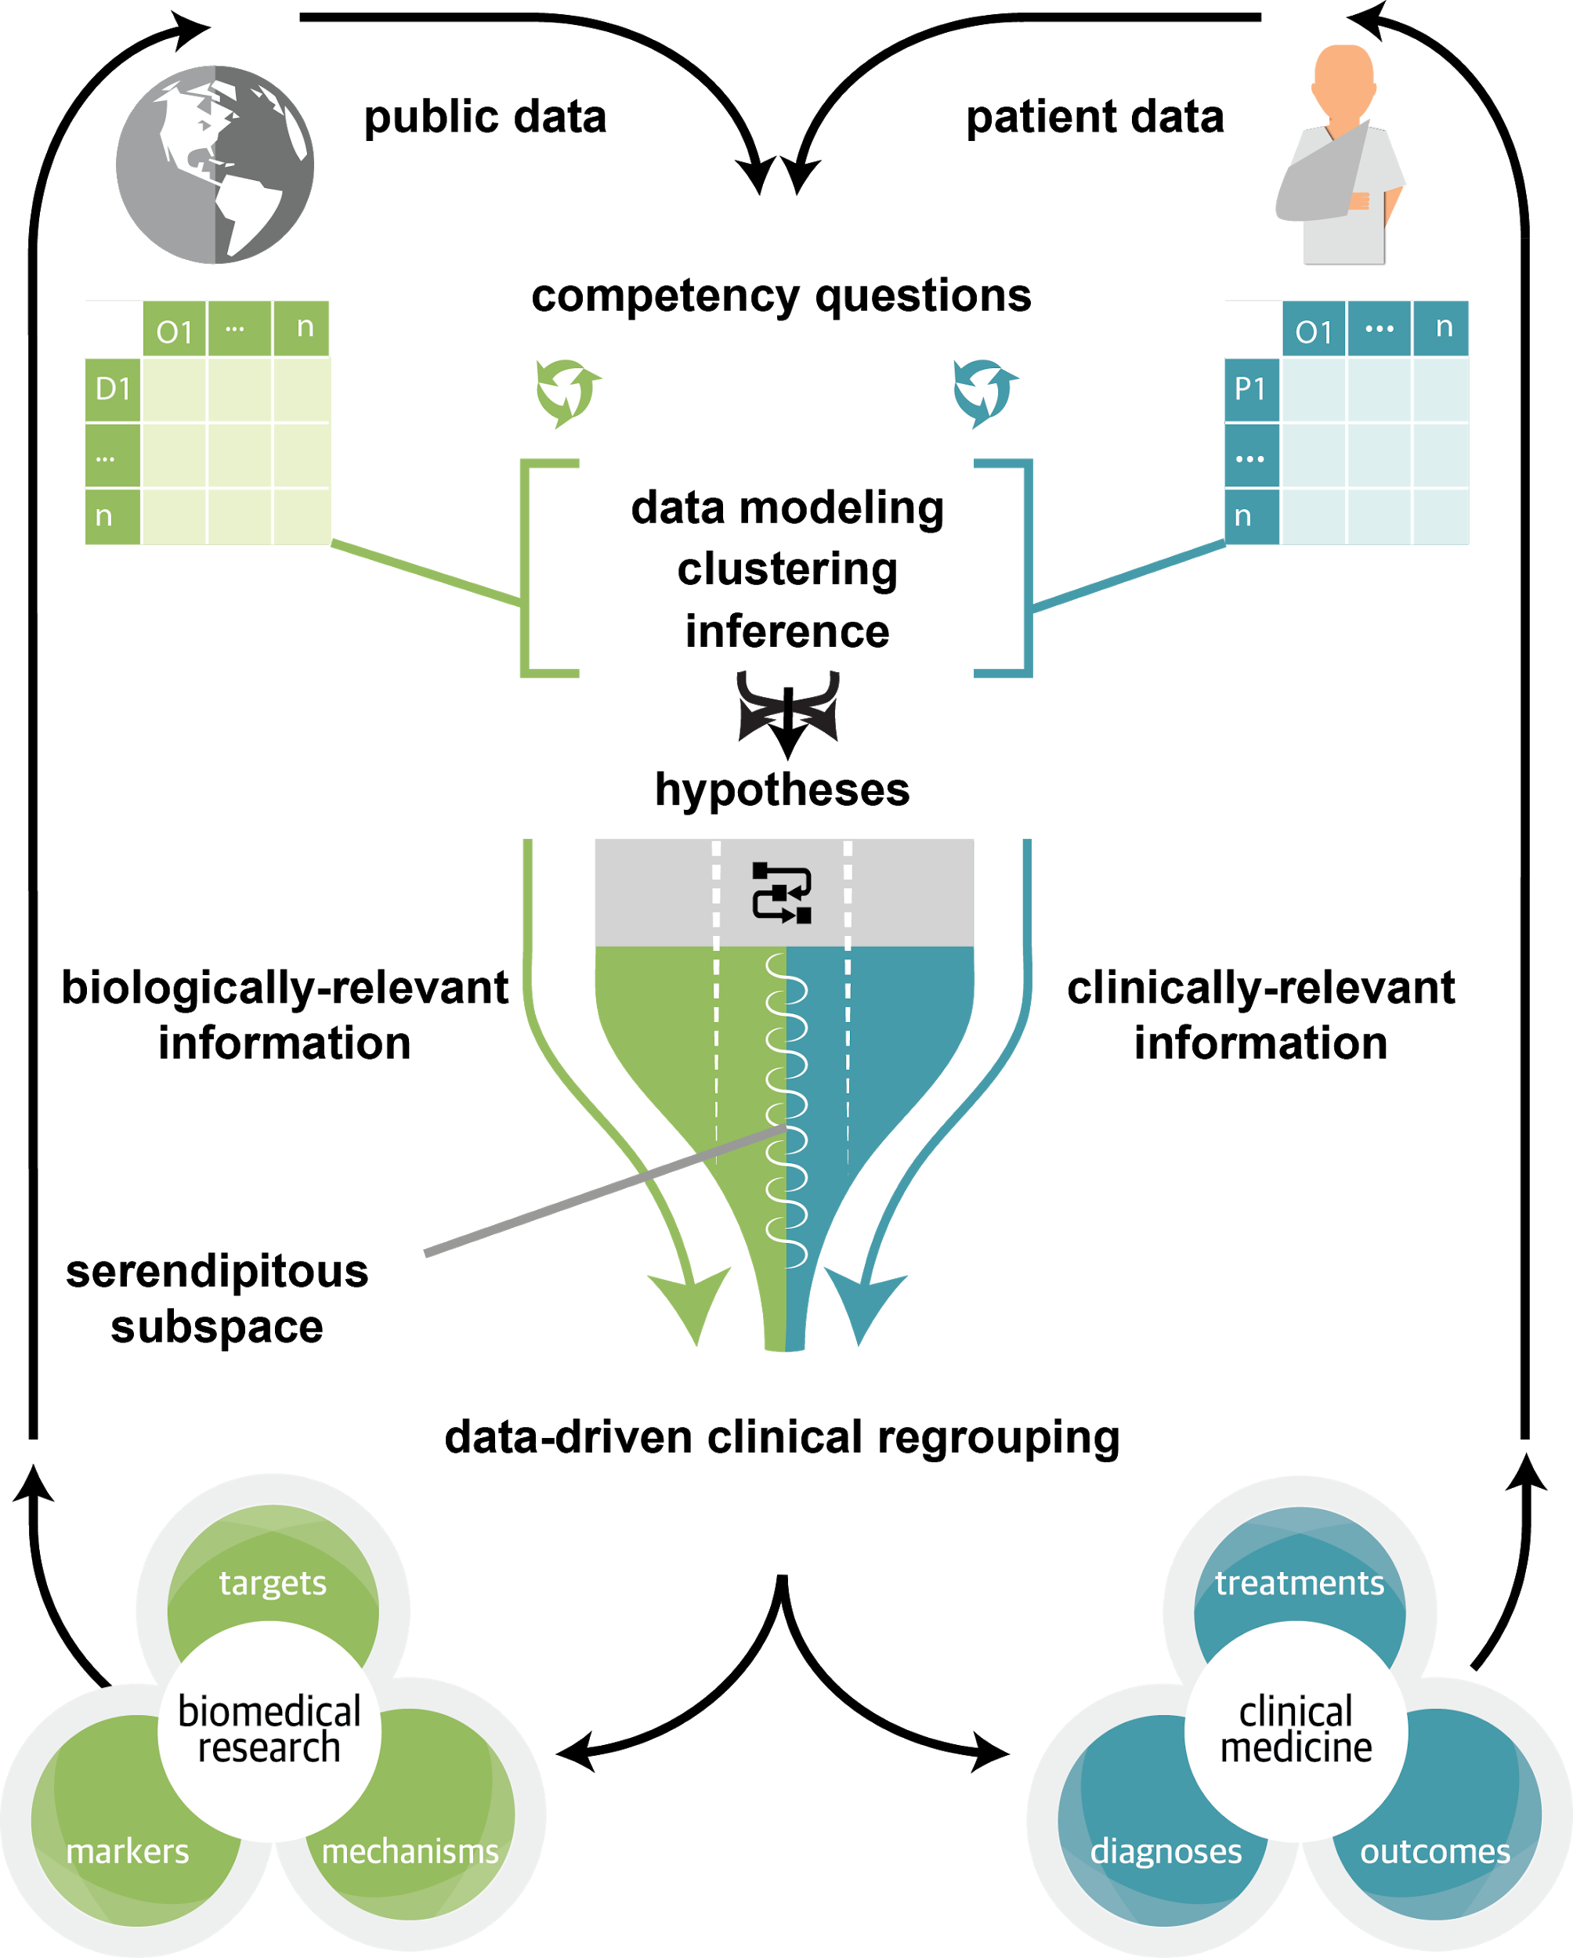
Biomedical Data Translator
“Two hundred years ago, chemists created a comprehensive enumeration of the elements and systematic relationships among them. We envision the Translator doing the same for translational science.”
̶ Christopher P. Austin, MD, director of NCATS, with Christine M. Colvis, PhD, Noel T. Southall, PhD
Enhance (but not replace) human reasoning, move beyond symptom-based definitions of disease toward a more mechanistic understanding
Austin CP, Colvis CM, Southall NT. Deconstructing the translational tower of babel. Clin Transl Sci 2019;12(2):85. doi:10.1111/cts.12595;
Fecho K, et al. The Biomedical Data Translator Consortium. Toward a universal biomedical data translator. Clin Transl Sci 2019;12(2):91–94. doi:10.1111/cts.12591.

Slide 35
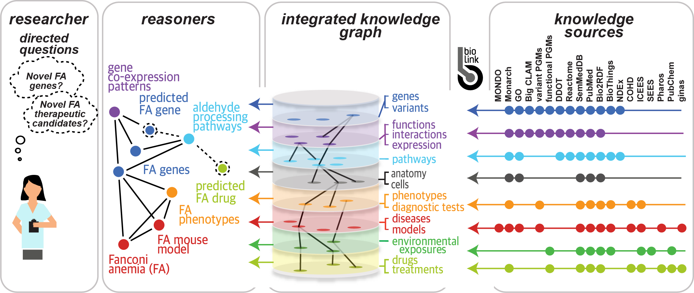
Prototype Translator System Architecture
Translator Knowledge Sources:
Biolink
Pharos
chem2bio2rdf
Knowledge Beacon Aggregator
Non-Translator Knowledge Sources:
quickGO
HGNC (synonyms)
OXO (synonyms)
Ontologies via ontobio:
MONDO
Human Phenotype
Novel Knowledge Sources:
UBERONGraph - Combination of Cell Ontology, Uberon, and Human Phenotype Ontology, with reasoning applied to make explicit relations
Support Edges:
Chemotext, Chemotext2: PubMed Term co-occurrence with MeSH (C1) or word2vec (C2)
CDWH: disease co-occurrence from the Carolina Data Warehouse for Health
Fecho K, et al. Clin Transl Sci 2019;12(2):91–94. doi:10.1111/cts.12591.

Slide 36
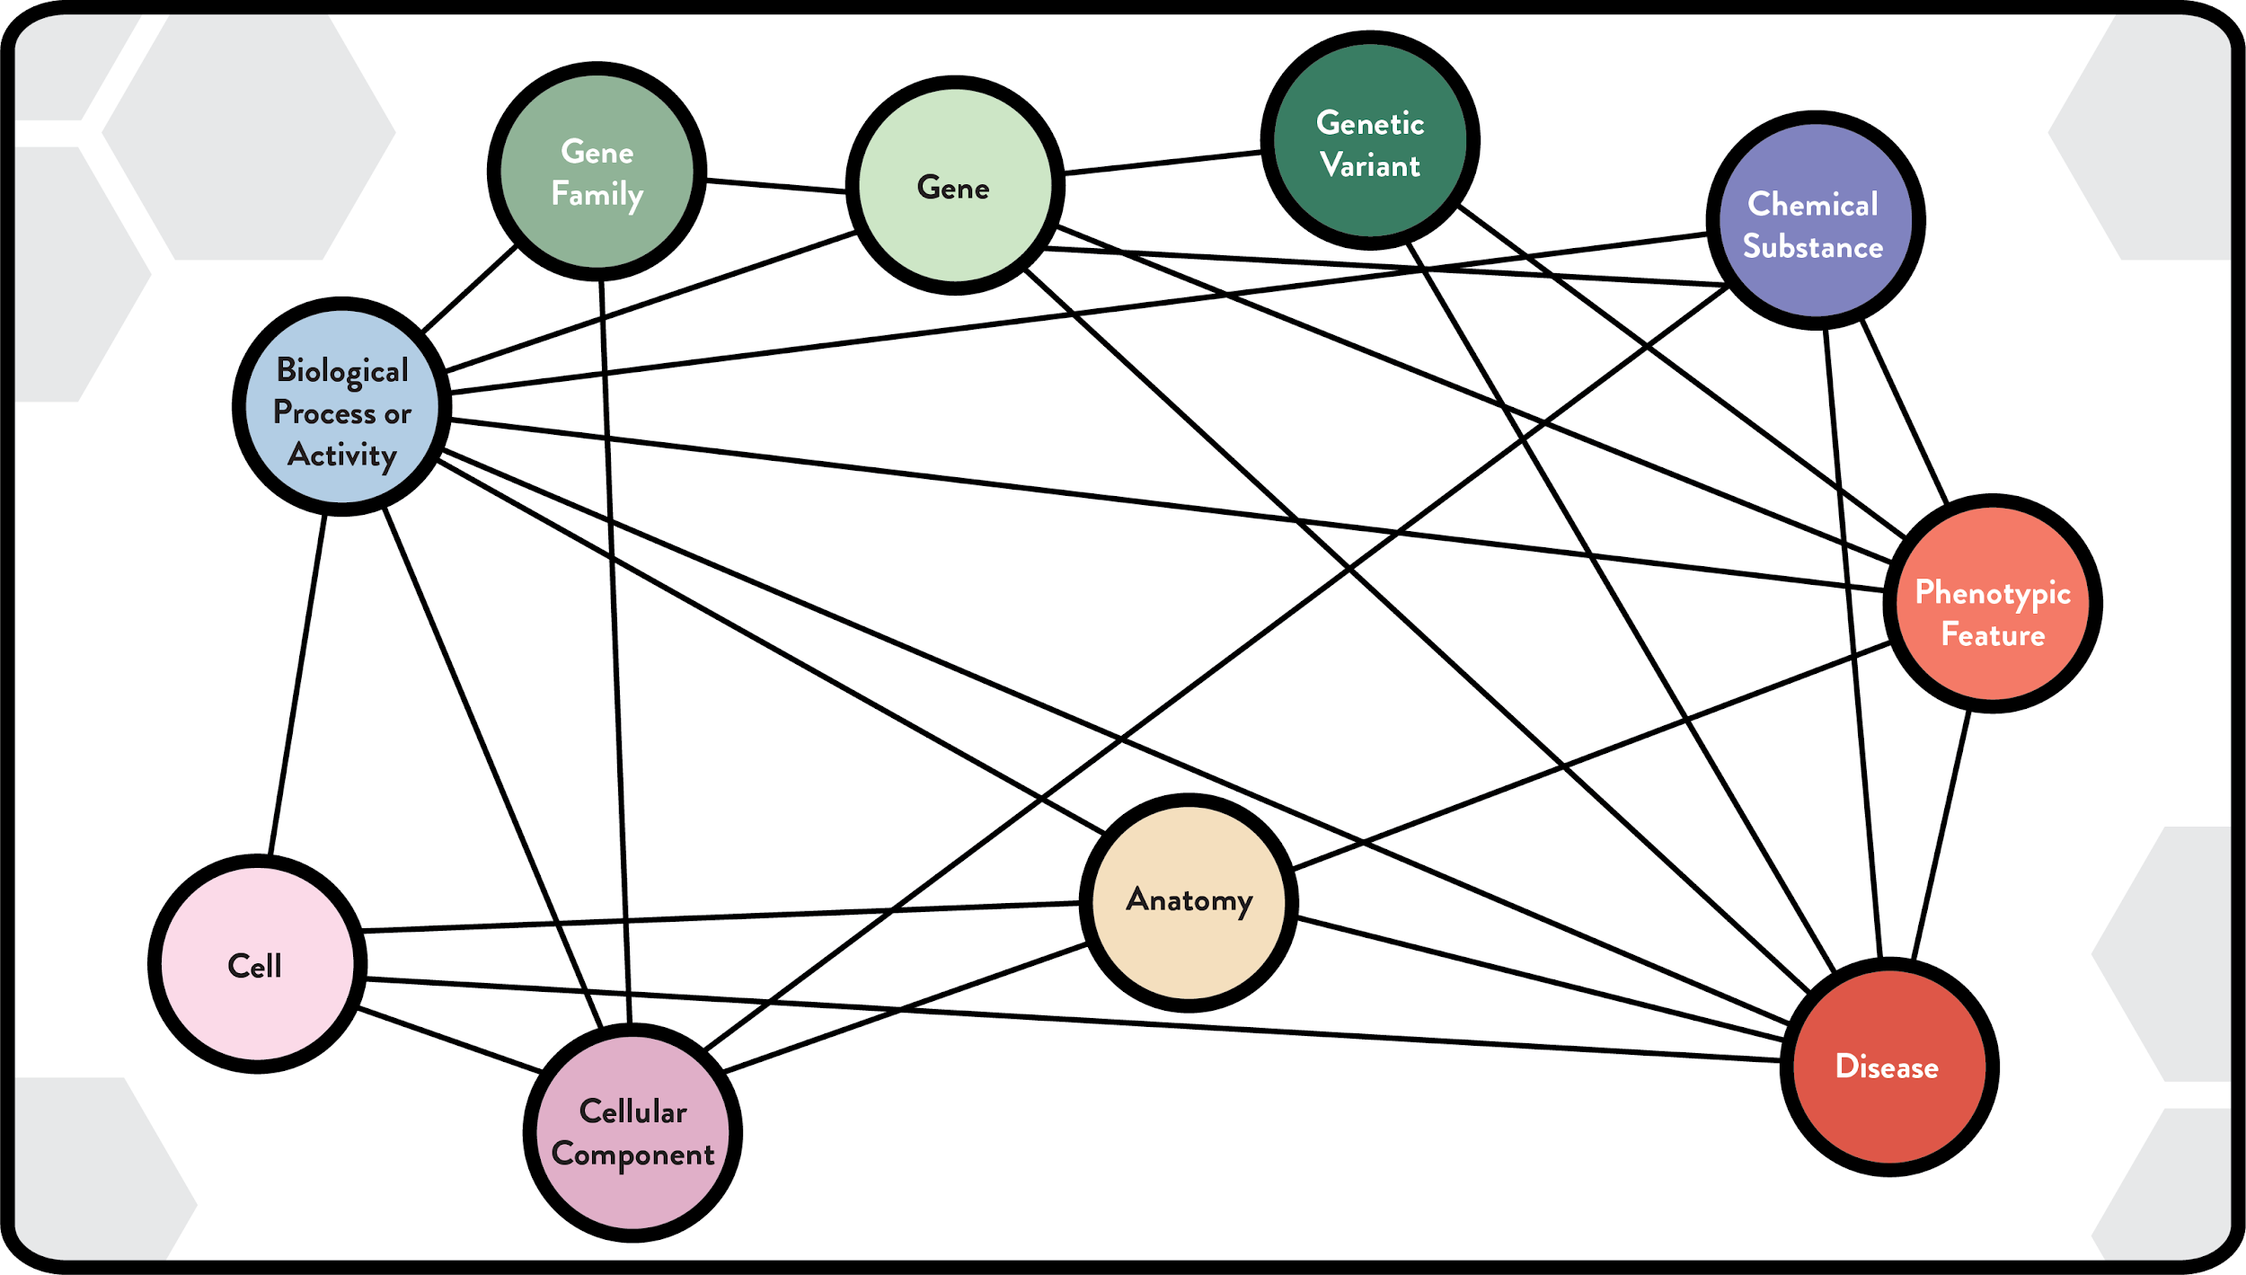
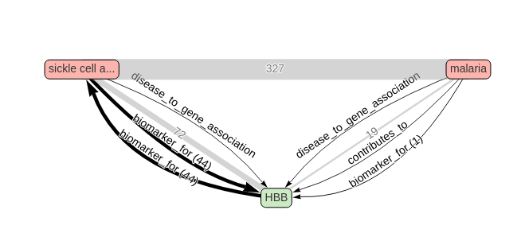
ROBOKOP (Reasoning Over Biological Objects in Knowledge Oriented Pathways): High-level Concepts Connected by Knowledge Sources
“Why is sickle cell disease protective against malaria?”
Publication co-occurrence support
Assertions on relationship & supportive evidence
FRAMEWORK IDEA: from very big “knowledge graph” of linked data relationships, use machine learning/clever algorithms to extract sub-graph(s) of high interest.
Bradford et al. INSS 2019
Morton et al. JAMIA, in press
Bizon et al. JCIM, under review

Slide 37
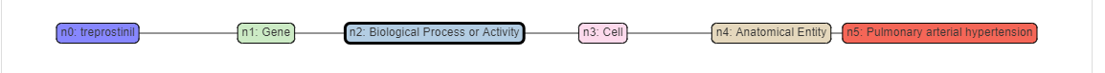
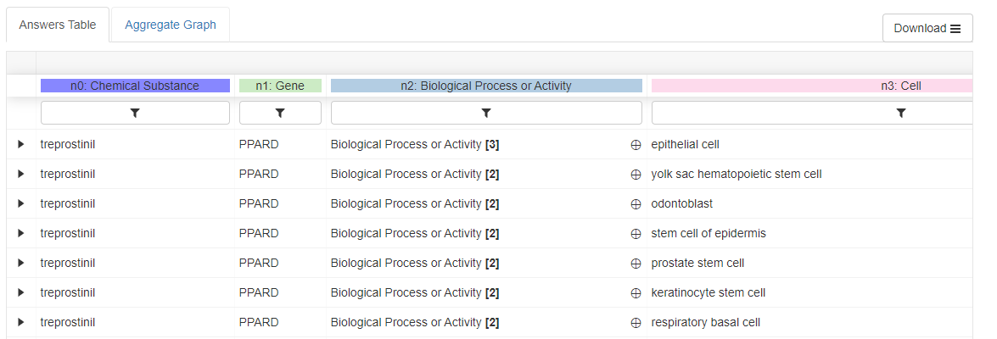
Clinical Outcome Pathways (COP) for drug applications: treprostinil-pulmonary arterial hypertension (PAH) case study
37

Slide 38
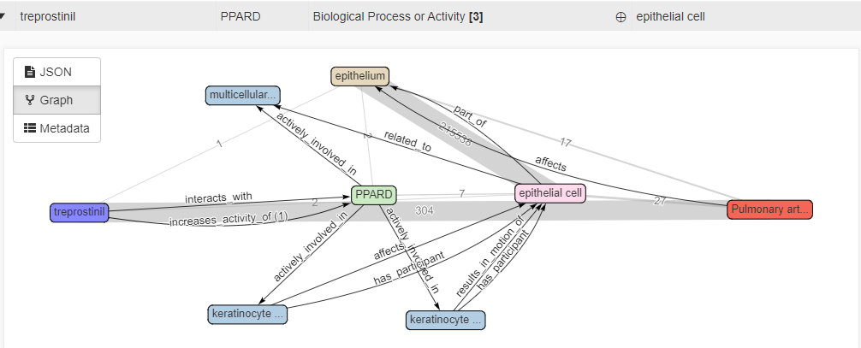
Treprostinil-PAH COP: best ranked answer
Treprostinil treats PAH by activation of PPARD pathway that helps in multicellular organism development, keratinocyte proliferation and keratinocyte migration. These processes help in the formation of the epithelial cells, leading to a healthier epithelium in pulmonary arteries.
38
Notes:
Treprostinil increases activity of Peroxisome proliferator activated receptor delta (PPARD).
PPARD is actively involved in multicellular organism development, keratinocyte proliferation and keratinocyte migration
All these biological processes somehow affect epithelial cells that are part of the epithelium, witch is affected by Pulmonary arterial Hypertension

Slide 39
What is research data?
Webster's 11th Collegiate Dictionary:
Factual information (as measurements or statistics) used as a basis for reasoning, discussion, or calculation
University of Leeds
Any information that has been collected, observed, generated or created to validate original research findings.
Multiple formats including both digital and non-digital: documents, spreadsheets, laboratory notebooks, field notebooks, diaries, questionnaires, transcripts, audiotapes, videotapes, photographs, films, test responses,…

Slide 40
Sources of research data*
Observational data - captured in real-time, and is usually irreplaceable (sensor data, surveys, sample data, images, etc).
Experimental data - captured from lab equipment; often reproducible, but this can be expensive (gene sequences, chromatograms, chemical bioactivity measurements).
Simulation data - generated from computational models of physical processes (climate models, economic models, molecular simulations).
Derived or compiled data - transformed from pre-existing data points; reproducible if lost, but this would be expensive (data mining, compiled databases, etc).
Reference or canonical data - static or organic conglomeration or collection of smaller (peer-reviewed) datasets, most probably published and curated (gene sequence databanks, chemical structures, protein x-ray structures, etc).
*University of Leeds

Slide 41
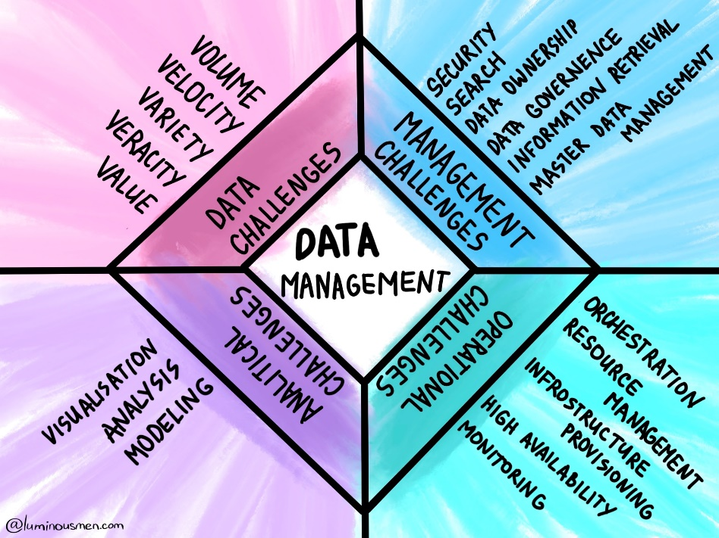
Why we should care about Research Data Management
Compliance with NIH Data Management and Sharing policy, effective Jan 25, 2023
Cost of inaction: loss of NIH funding
Protection (in terms of, either or both, IP and sensitivity, e.g., personal or clinical data)
Preservation and findability itical to protect research integrity/ reproducibility/accuracy and uniqueness of research

Slide 42
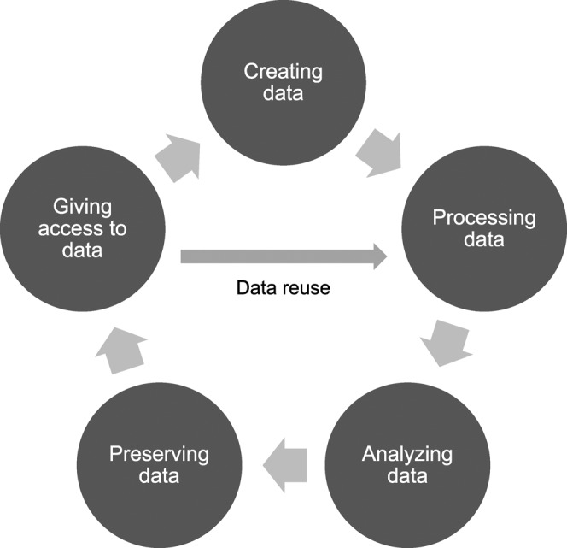
Research Data Management (RDM): Key Definitions
Data Sharing: The act of making scientific data available for use by others (e.g., the larger research community, institutions, the broader public), for example, via an established repository
Metadata: Data annotation intended to make scientific data interpretable and reusable
Image source: J Med Libr Assoc. 2015 Jul; 103(3): 154–156

Slide 43
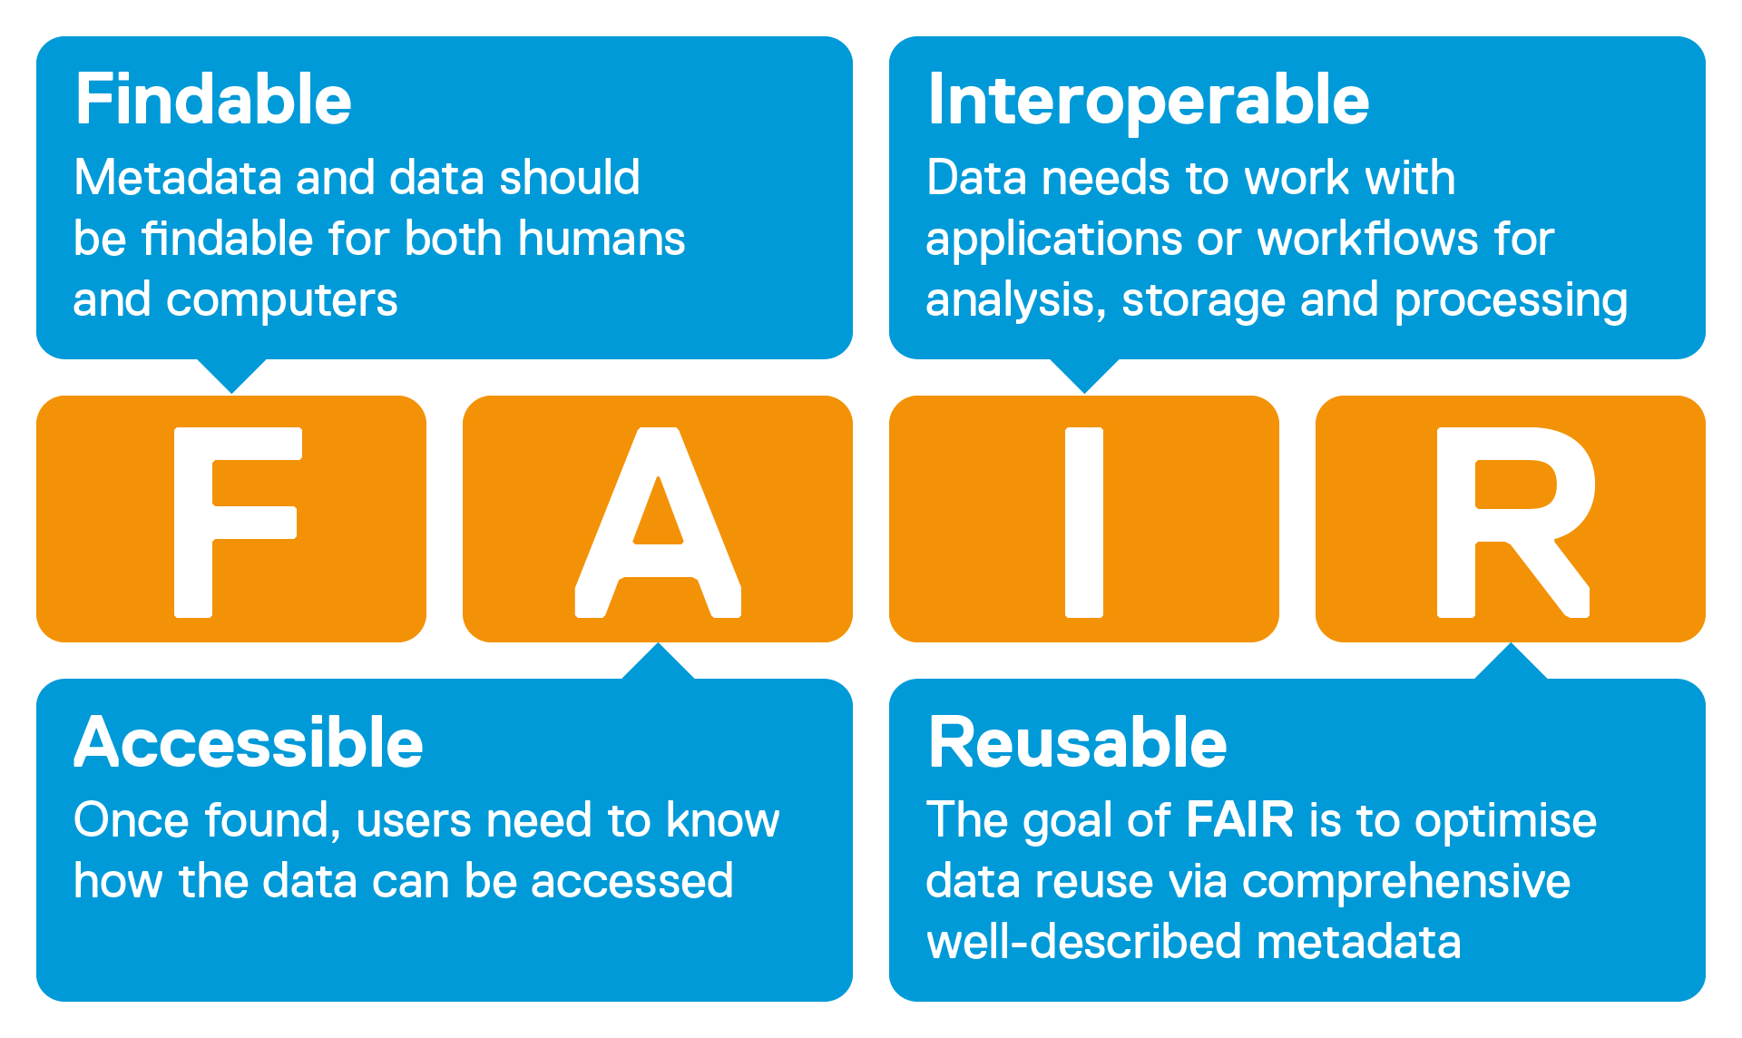
Key elements of RDM
Primary data recording
Archiving (e.g., LabArchives; UNC has signed up https://mynotebook.labarchives.com/login )
Structuring based on field-specific ontology and data dictionary
Establishing rules and mechanisms of data sharing
within laboratory
with colleagues at UNC
with colleagues in academia
with colleagues in industry
with no restrictions
Processing
Preserve all steps of raw data transformation
Publishing
Preserve linkage to raw data and all data processing protocols
Enabling effective search

Slide 44
Practical steps
Establish data stewards in each laboratory
Identify protocols for electronic data entry in each laboratory
Types of data (text, images, curves)
Software that records data (instrument-related?)
Manual or automatic entry (i.e., notes vs instrument readouts
Data curation protocols
Raw data to publication-level tables and figures
Data record keeping
Identify respective data repositories for each research project (per NIH NOT-OD-21-016)
If NIH specifies a data repository, use that data repository
If there is an established domain specific data repository, use that data repository
Small datasets (<2GB): Pubmed Central or Institutional Repo (e.g., https://cdr.lib.unc.edu/)
Large datasets: cloud-based data repositories for data access, preservation, and sharing

Slide 45
Research Data Ownership
The University has an established policy on data ownership
Goal is to ensure research data is secured and appropriately accessible
The University owns all Research Data generated with the support of University resources.
The University may copy and access any Research Data regardless of where it is stored, including personal devices.
In addition to ownership, the University maintains Control of the original Research Data.
If requested and approved through the UNC Research Data Transfer Form, University faculty, staff, and students who generate research data as a Principal Investigator (PI) on a project may keep a copy of the Research Data.
When leaving the University, a PI may take copies of Research Data that they generated during their research.

